Slide 1
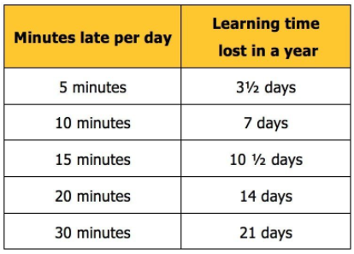
11th
2024
Attendance
CLASS PERCENTAGES
EYFS 97%
HOLLY 98.3%
OAK 93.6%
CHESTNUT 95.5%
WILLOW 92.1%
ASH 92.5%
BEECH 95.4%
YEW 99.4%
MAPLE 97.5%
ASPEN 95.8%
BIRCH 94.8%
SYCAMORE 97.2%
The winning class year to date is Yew, a big well done to all of the children in Yew class!
Newsletter
Dear Parent/Carer,
WHAT ARE MY RESPONSIBILITIES REGARDING MY CHILD’S SCHOOL ATTENDANCE?
As a parent/carer it is your responsibility to ensure that a child of compulsory school age attends school both regularly and punctually. School and the local authority has a duty to ensure that all parents/carers fulfil this responsibility.
Attendance Monitoring
As attendance and punctuality is so important to us, we cannot be complacent where there are instances of unacceptable, low pupil attendance, or if pupils are regularly late to school. We may send text messages, make calls home, make home visits, send letters or hold meetings to try and address any concerns.
If there is not an improvement in attendance, then you may be asked to come into school for a formal meeting to discuss the matter further. Jubilee’s Education Welfare Officer may also attend this meeting.
If unauthorised absences continue, this could then result in a referral to the Local Authority.
The new threshold is 10 sessions of unauthorised absence in a rolling period of 10 school weeks.
Fines
These fines are per parent, per child and are not paid to the school -
First Offence – The first time a Penalty Notice is issued the amount will be:
£160 per parent, per child, paid within 28 days.
Reduced to £80 per parent, per child, if paid within 21 days
Second Offence (within 3 rolling years) – The second time a Penalty Notice is issued the amount will be:
£160 per parent per child paid within 28 days.
Third Offence and Any Further Offences (within 3 rolling years) – The third time an offence is committed a Penalty Notice will not be issued and the case will be presented straight to the Magistrates Court.
Punctuality
School starts at 8.30am but did you know the doors open at 8.15am
Late to school = Missed learning & missed opportunities

Slide 2
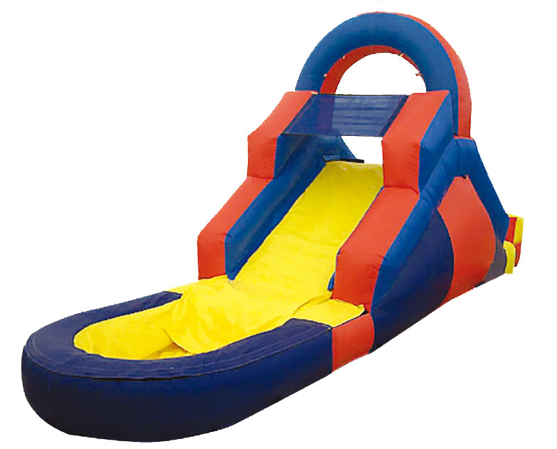
BENEFITS OF HIGH ATTENDANCE:
Good attendance = high achievement
It gives students the best chance of being successful at school
Evidence shows students make better progress and get better results than students with poor attendance
It allows students to be able to be involved in all activities that the school runs
It supports students to develop positive social relationships with friends and staff
At the start of terms, particularly when classes are new, or where there are planned assessments being held at school, students miss out on key times in their education
It promotes a good work ethic
Incentives, Rewards and Prizes
Did you know that your child can earn rewards and prizes for being in school every day! To recognise that children have 100% attendance each term they can win various prizes as well as a certificate to acknowledge their achievement.
At the end of the academic year there are also larger prizes and treat days for children who end the academic year above 98% attendance.
Late marks are also taken into account, children are only allowed a maximum of 2 late marks per term with an attendance percentage of 100% to be in with a chance of winning a large prize at the end of the academic year.
Please don’t give up if your child misses a day of school, there are lots of various prizes for the children to win.
The children must be in to win!!
If you would like more information on your child’s individual attendance, please speak to Mrs O’Connor.

