Slide 1
Family Maths Toolkit
Scrapbook
As part of the National Numeracy schools and families program, we are aiming to increase pupils’ confidence with numbers, give children and families a positive feelings about maths as well as build an awareness of the value of maths outside the classroom.
The scrapbooks are used to record each weeks maths task in anyway you like!
Please remember to add family comments and the child comments after each task.
Thank you to everyone who has started using the scrapbooks to complete each weeks maths tasks! We have seen some excellent work so far.
When children bring their completed work back, they will receive a Maths Champion Stamp!
As they collect more stamps, they can start spending them in the Maths Shop!

Slide 2
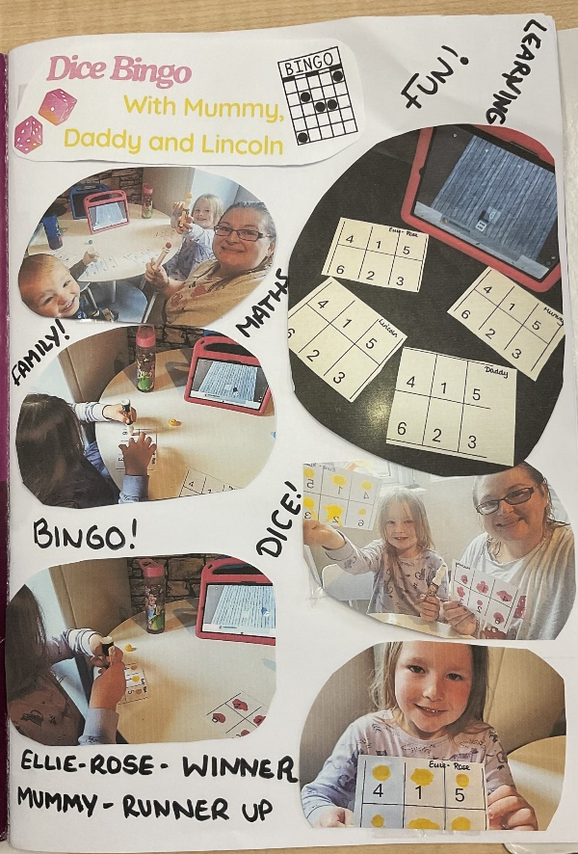
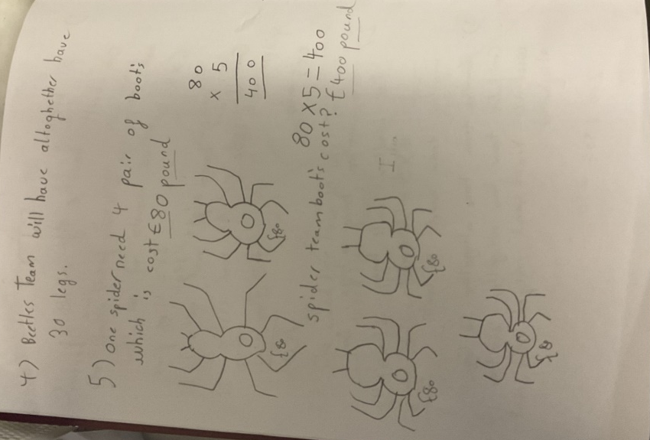
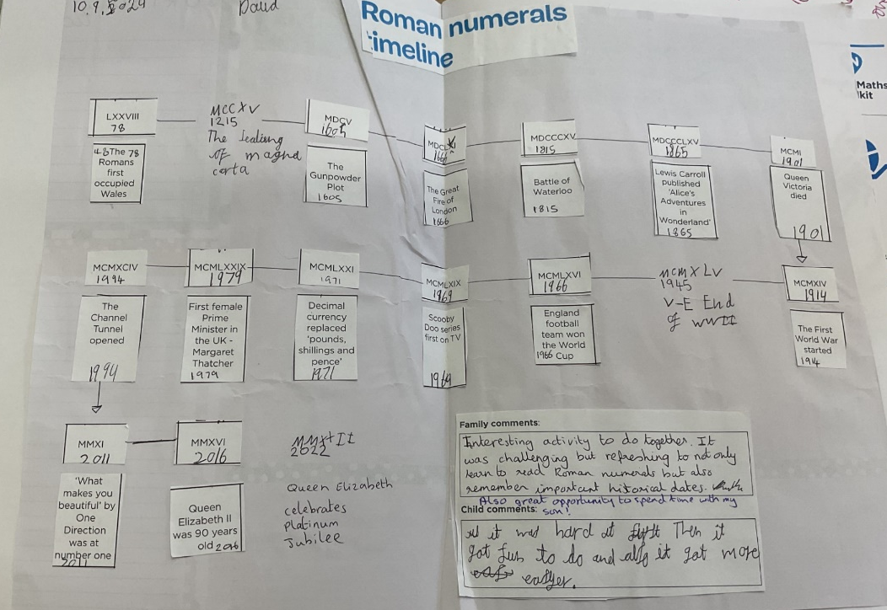
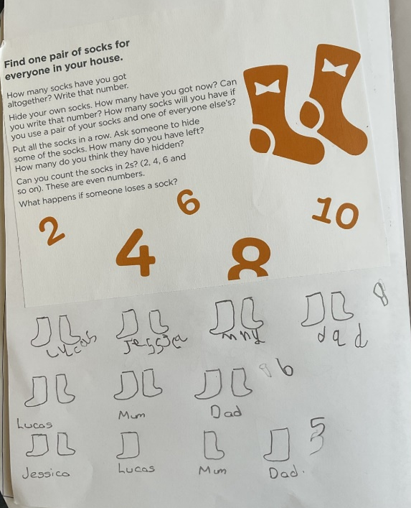
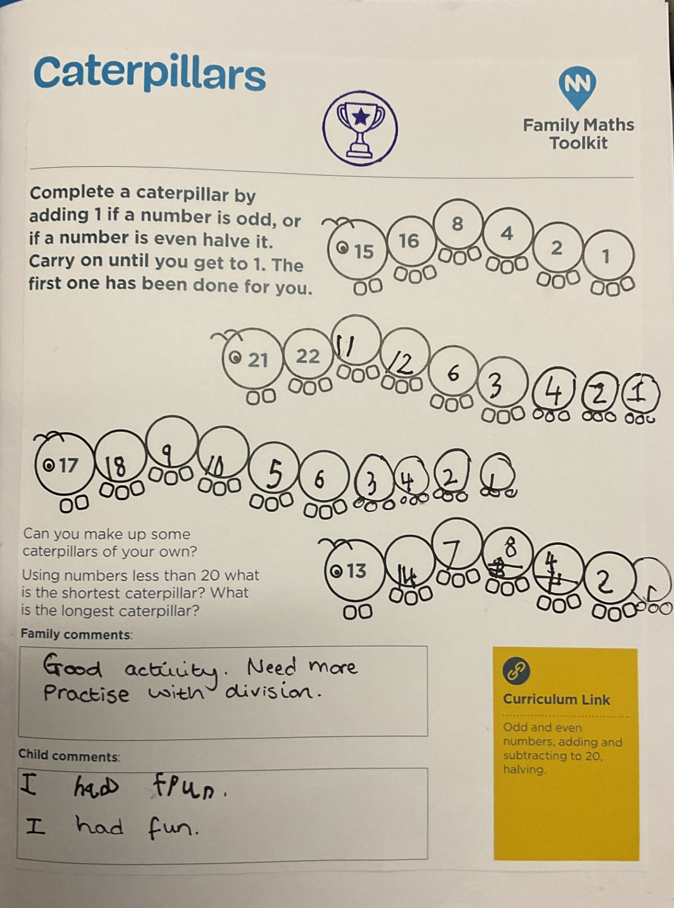
Examples of how you could use the scrapbooks

