Slide 1
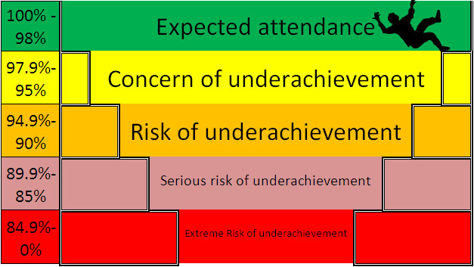
8th
2024
Attendance
CLASS PERCENTAGES
FIR 98%
PINE 94.3%
HOLLY 96.7%
OAK 95%
CHESTNUT 94.3%
WILLOW 94%
ASH 95.8%
BEECH 95.8%
YEW 99.1%
MAPLE 97%
ASPEN 96.6%
BIRCH 94.9%
SYCAMORE 97.3%
The winning class year to date is Yew, a big well done to all of the children in the Yew class!
Newsletter
Dear Parent/Carer,
At Jubilee L.E.A.D Academy we seek to ensure that all pupils receive a full time and appropriate education, which will enable them to achieve their potential. For a child to reach their full educational achievement and take full advantage of the educational opportunities offered a high level of school attendance is essential. The routines children develop around attendance and punctuality at school are key for high attainment, confidence with peers and staff and future aspirations.
Did you know……
The Department for Education (DfE) has stated, ‘persistent failure to send children to school is a clear sign of neglect’. The NSPCC has cited, ‘failure to ensure regular school attendance which prevents the child reaching their full potential academically’ as one of their six forms of neglect.
‘Working together to safeguard children’ provides a neglect description, ‘The persistent failure to meet a child’s basic physical and/or psychological needs, likely to result in the serious impairment of the child’s health or development’
Attendance duty
Where parents decide to have their child
registered at school, they have an additional
legal duty to ensure their child attends that
school regularly. This means their child must
attend every day that the school is open,
except in a small number of allowable
circumstances, such as being too ill to attend.
HOLIDAYS
Holidays are not authorised during term time, any holidays taken will be referred to Education Welfare where fines may be issued

Slide 2
Punctuality
Our doors open at 8.15am to enable our children to be in class and ready to learn by 8.30am. If you are experiencing any difficulties getting your child to school on time please speak to Mrs O’Connor who can support you.
Incentives, Rewards and Prizes
Did you know that your child can earn rewards and prizes for being in school every day! To recognise that children have 100% attendance each term they can win various prizes as well as a certificate to acknowledge their achievement.
At the end of the academic year there are also larger prizes and treats for children who end the academic year above 98% attendance.
Late marks are also taken into account, children are only allowed a maximum of 2 late marks per term with an attendance percentage of 100% to be in with a chance of winning a large prize at the end of the academic year.
Please don’t give up if your child misses a day of school, there are lots of various prizes for the children to win.
The children must be in to win!!
Last day of term – Friday 20th December (children must be in school on this day.
Prize giving assembly will be on the last day of term where 3 children will win a chest of games and attendance prizes & certificates will also be given out on this day.
First day of the Spring term – Tuesday 7th January 2025
If you would like more information regarding your child’s individual attendance, please speak to Mrs O’Connor.

