Slide 1




4th
2025
SEND Newsletter
Dear Parent/Carer
Welcome to our latest edition of our Special Educational Needs and Disabilities (SEND) newsletter.
Firstly it wouldn’t be right not to mention our schools latest Ofsted inspection, which we are extremely proud of - particularly the positive feedback that highlighted our SEND provision. Inspectors noted that “pupil’s with SEND have their needs accurately identified and that the school provides the precise support these pupils require”.
In this issue we think about the final weeks of term and the preparations that are already underway in school for a smooth transition in September. We recognise that leaving the familiarity of an old class, or school, to begin somewhere new can be an anxious time for both children and parents, so we are working hard to ensure that conversations happen and interventions are consistently delivered from one year group to the next.
Some children will require more support and therefore providing a transition booklet containing pictures of their new class teacher, Teaching assistant and environment can be helpful.
Please update us with any new or helpful information you may have in order to update medical files and SEND support.
Please read on to explore tips and guidance for what you can do to support your child's positive transition.
Best wishes
Liz Anscombe
Assistant Head of School and SENDC0

Slide 2
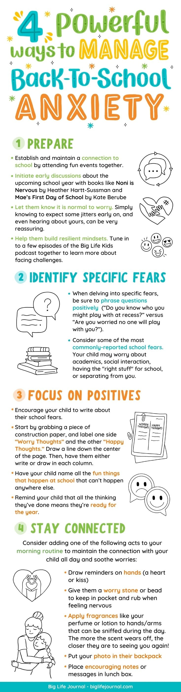
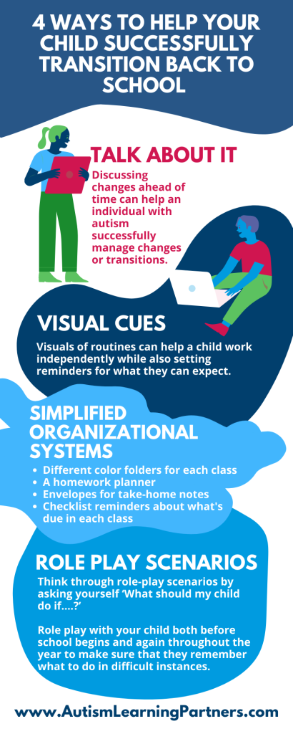

Slide 3
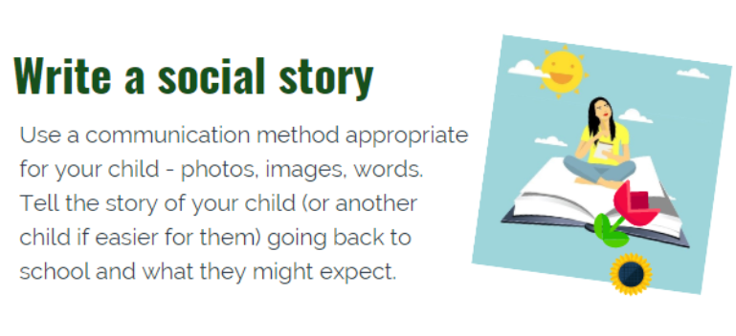
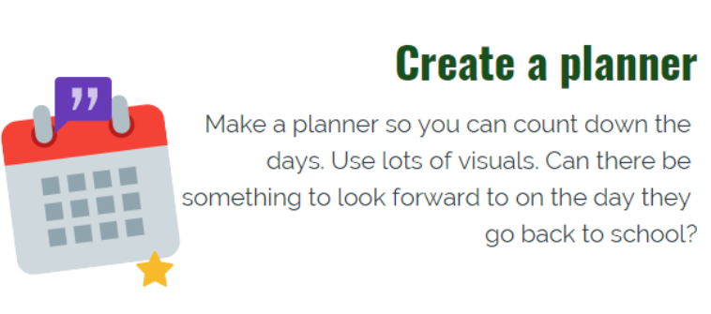
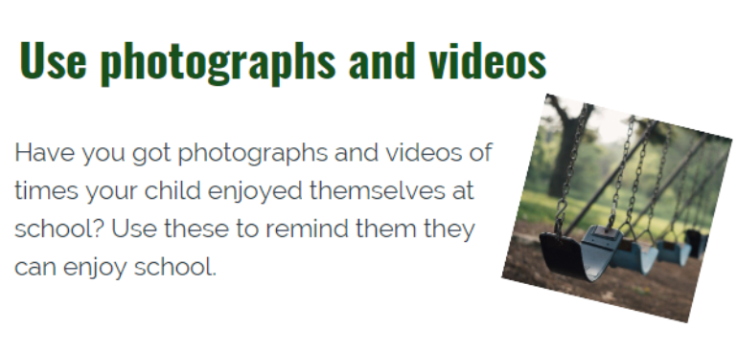
Useful Links
https://www.place2be.org.uk/our-services/parents-and-carers/getting-ready-to-start-primary-school/
https://www.nottinghamcity.gov.uk/media/bpql3dkg/successful-transitions-in-the-early-years.pdf
https://www.caretech-uk.com/supporting-transition-back-school-tips-parents-carers-young-people-autism
https://livingautism.com/transition-back-school/

