Slide 1


Newsletter
https://jubilee.nottingham.sch.uk/
Friday 17th October 2025
Dear Parents/Carers,
Firstly, I would like to thank all of those who were able to join us for our recent Parents’ Evening. Our teachers were delighted to see so many of you taking time to discuss your children’s education. By working together, we are able to achieve wonderful heights and fully prepare pupils for their lives ahead.
In addition, it was also a delight to have had overwhelmingly positive feedback from the parents/carers who completed the survey. We are very proud that all of your responses felt the school makes sure pupils are well behaved. In addition, 96% of you agree/strongly agree that your child is safe in school and 97% feel your child does well at this school.
We have once again made sure pupils are accessing a wide range of opportunities from the start of this academic year. These have already included:
Pupils in Year 2 visited Bolsover Castle where they developed their historical understanding of castles.
Pupils in Year 4 have begun their weekly guitar lessons and are quickly developing into musicians of the future.
Pupils in Year 5 completed their Bikeability sessions where they learned how to safely check and ride their bicycle on local roads.
There have already been lots of sporting fixtures and events where many different pupils have represented the school in either competitive or non-competitive situations.
After school clubs have been incredibly well attended once again and we have been delighted to see so many faces attending these sessions.
There are also many more exciting events planned for after the holidays which we will continue to share with you.
As we celebrate our successes, we would also like to wish those of you either currently celebrating or about to celebrate religious festivals or special celebrations a wonderful time. Our school curriculum supports pupils to learn about a variety of religions as part of the National Curriculum. Pupils learn about how people from all around the world live their lives in order to better understand and support one another. This was made even more special this year as we were able to welcome one of our parents into school to support our pupils to learn about Diwali. Please see the following page for more information. For more information about our RE curriculum, please look at our website or ask to speak to our RE leader Mrs Matumbike.
Please have a safe and restful half-term holiday and I look forward to seeing all the pupils once again at 8:15am on Monday 3rd November.
Yours Sincerely,
Mr Brooks
Head of School

Slide 2
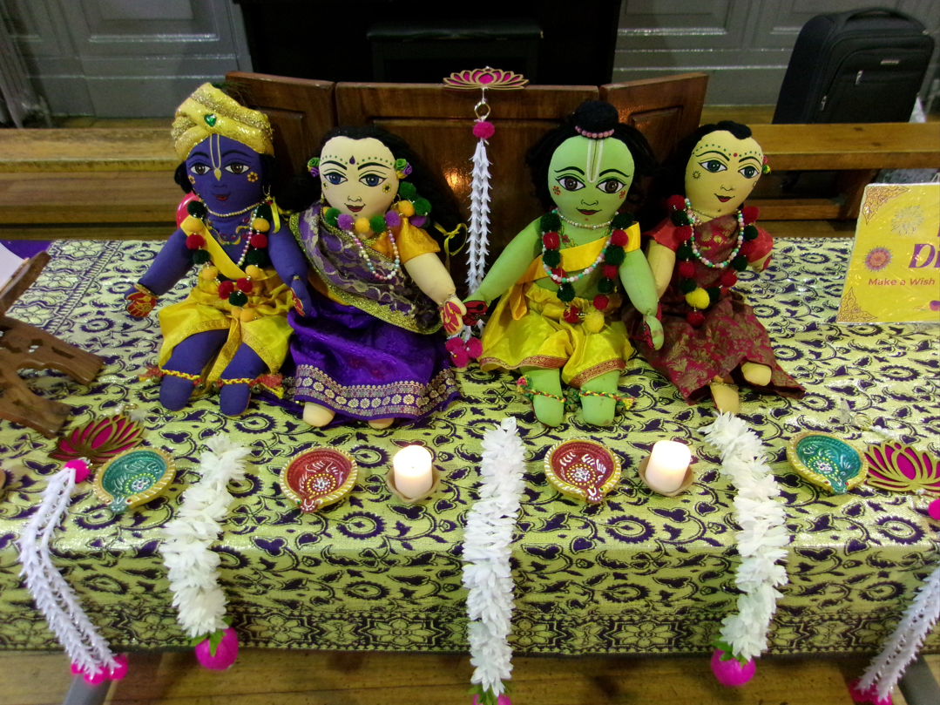
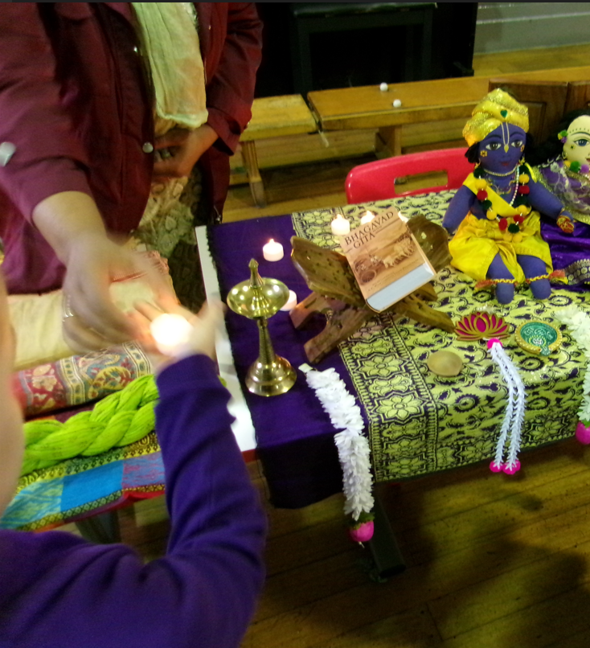
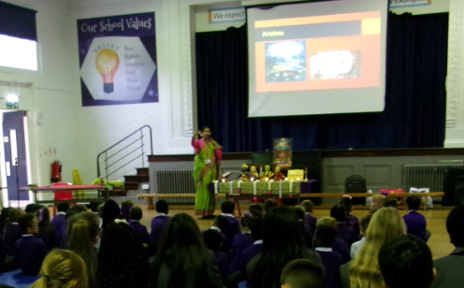
What an experience our Year 3 and Year 5 children have had this week! Many thanks to some of our wonderful parents who volunteered to come in to school and help our children learn about Diwali.
Our children had the opportunity to develop their understanding in the telling of the story behind the festival and got to ask questions to deepen their knowledge.
Thank you once again to our wonderful volunteers!
Also, to those celebrating, we hope you have a Happy Diwali.
If you would like to support learning at our school, or volunteer in some other way (for example supporting visits or volunteering to help on projects, please use the information on the next page.

Slide 3





Thank you to those who have already offered their time to support our school.
We are always on the lookout for helping hands so please see the information below…
If you need any information or need to speak to someone about your child or any other matter:
PLEASE CALL THE SCHOOL OFFICE ON:
0115 9155719
or email admin@jubilee.nottingham.sch.uk
You can also contact us via the School Gateway App

Slide 4

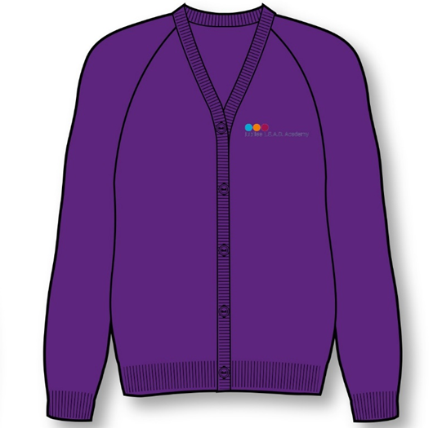
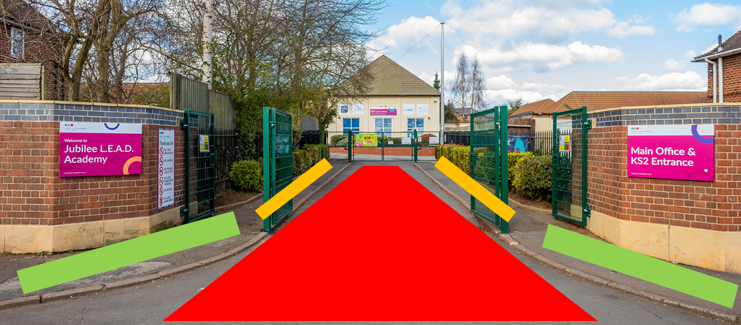
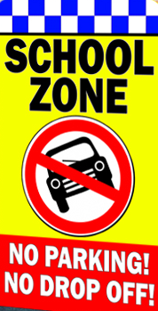
School Dinners
School dinners are free for children in
EYFS, Y1 and Y2.
For children in Y3 onwards the cost of a school meal is rising to £2.80 per day. Please ensure that this is paid in advance.
School Uniform
Please remember to name all your child’s school uniform, this helps us to return it to you if it’s been misplaced.
Uniform can be ordered by the Gateway app and collected from the school office.
Don’t forget we also sell ‘pre-loved’ uniform which many of you bought during our recent Parents’ Evening. Please speak to the office for more information on this.
Dates for your Diary
October half term 20th Oct – 31st Nov 2025
School restarts – Monday 3rd November 2025
Tuesday 18th November Year 6 Holocaust Centre
Wednesday 19th November Year 3 Creswell Crags
Friday 14th November – Children in Need – more information to follow
Tue 2nd – Tue 9th December – Book Fair
CURRICULUM CLUBS
The curriculum after school clubs are going really well on Mondays. The final 3 weeks will be held after the half term. For those pupils that missed out this term, look out for more opportunities in the Spring term.
School Entrance Advice
Please remind your child to use the footpaths when waiting for school to open at 8:15 because this road is used by vehicles until then (see image to the left)
Highway Code says. Rule number 243 states "do not stop or park" in front of an entrance to a property.
Please be advised that due to the volume of vehicle users not observing the road restrictions, we have requested that PCSO’s arrange spot checks on the road in the very near future.

Slide 5
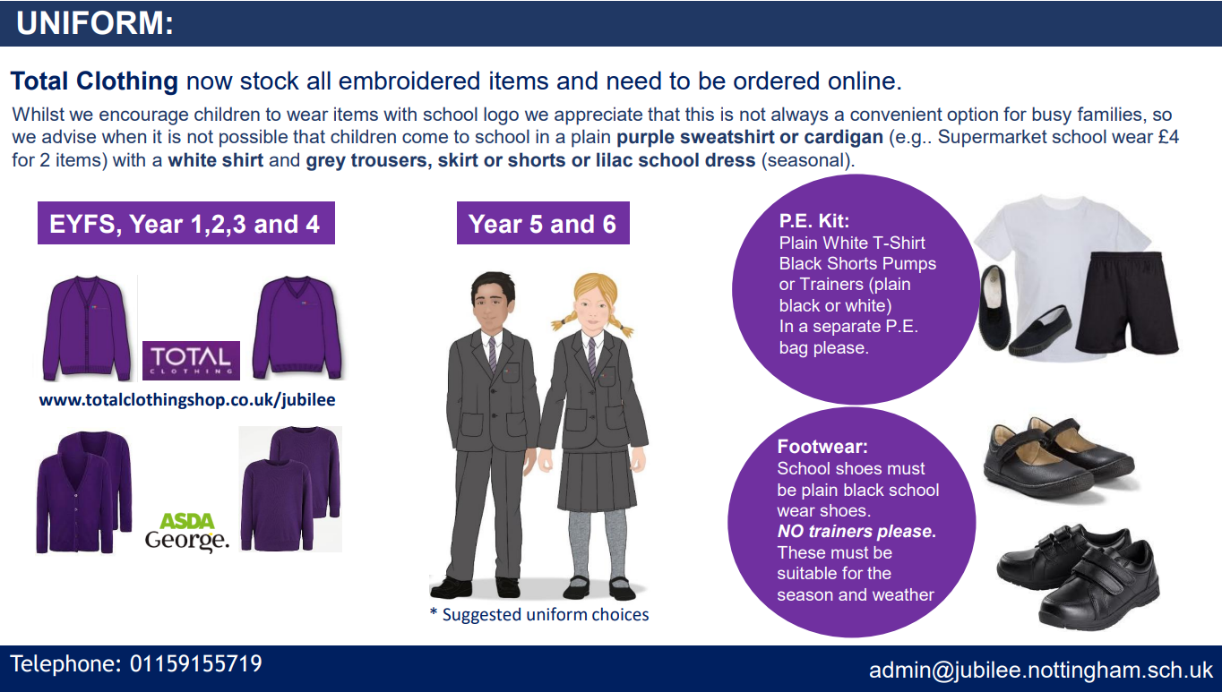
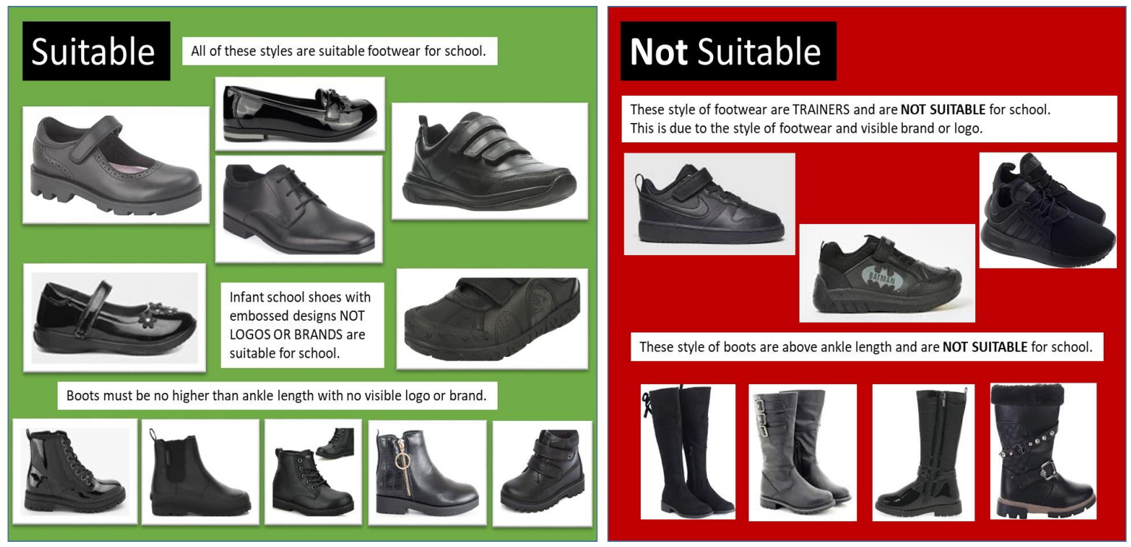
Helpful Information
YEAR
6
GOOD
LUCK!
Earrings: One small metal studded earring per ear. For health and safety reasons we cannot permit other styles of earrings including hoop, or drop earrings. No other jewellery is permitted apart from appropriate wrist watches (to be decided at the discretion of the school)
Make-up, including skin-art, nail varnish and false nails are not permitted. For health and safety reasons, finger nails should remain natural and kept short to avoid injuries during times such as PE. No extreme haircuts or colours are permitted (to be decided at the discretion of the school). No lines, patterns or shapes (including logos) are to be shaved/cut into hairstyles. Thank You

